Slide 1
RCRS: Animal Research

Slide 2
Discussion of paper/NPR discussion
What are your thoughts on the article, do you agree or disagree?
Here are some talking points
From a moral perspective, do you think animal use is justified, if so when?
What are your thoughts on Justin’s concerns about animal research not translating to human health?
Would the knowledge that a charity supports animal research affect your desire to donate?
Is it reasonable to choose to opt out of supporting animal research (for example via taxes), what would be the repercussions of this?
Thinking of different levels of species (bacteria, rats, monkeys, humans) at what level would you be comfortable using as subjects? Why?

Slide 3
Is Animal Research Unreliable Relative to Human Research?

Slide 4
Objective
Understand policies regarding live vertebrate animal subjects in research

Slide 5
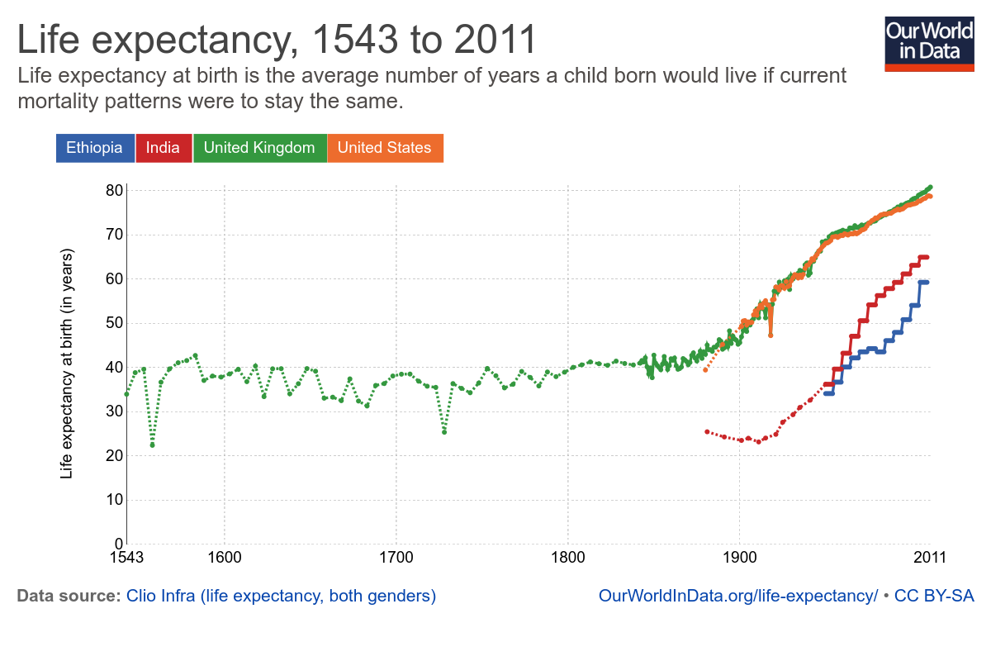
Some Advances Made Possible by Animal Research
1726 First Measurement of Blood Pressure (Horse )
1790-1888 Vaccines for Smallpox, Antrax, Rabies Developed (Cow, Sheep, Dog, Rabbit )
1902 Malarial Life Cycle Discovered (Pigeon )
1905 Pathogenesis of Tuberculosis Discovered (Cow, Sheep )
1919 Mechanisms of Immunity Discovered (Guinea Pig, Horse, Rabbit)
1923 Insulin Discovered (Dog, Fish )
1929 Vitamins Supporting Nerve Growth Discovered (Chicken )
1932 Function of Neurons Discovered (Cat, Dog )
1956 Open Heart Surgery and Cardiac Pacemakers Developed (Dog )
1964 Regulation of Cholesterol Discovered (Rat )
1989 Organ Transplantation Developed (Dog, Sheep, Cow, Pig)
1995 Gene Transfer for Cystic Fibrosis Developed (Mouse, Non-Human Primate)
2001 Promising Drug for Prevention of AIDS Developed (Monkey )
Ourworldindata.org
Notes:
Since 1900, modern medicine has boosted th eaverage life span in the United States by almost 30 years
Animal reserch has played a role in essentially all of these advances

Slide 6
Levels of Regulatory Oversight
Veterinarian/Husbandry | Experimenter | PI | IACUC | OLAW , USDA-APHIS and AALAS | Funding Agencies
Monitor animals | Follow protocol | Write protocol | Review and approve protocols, compliance with OLAW/ AALAC/USDA | Certify institutional IACUC | Assure experiments are scientifically necessary
Notify/assist in adverse health events | Complete training | Ensure training by staff | Internal inspections twice a year | Site inspections, review protocols
 | Alert veterinarians to adverse health |  | Suspend activities and report noncompliance
 |  |  | Investigate concerns
Notes:
APHIS is Department of Agriculture, Animal and Plant Health Inspection Services

Slide 7
Composition of the IACUC
Institutional Animal Care and Use Committee
Appointed by Vice President of Research
Scientists
Non-scientists
Veterinarians
Members of general public

Slide 8
What kinds of subjects are covered by institutional IACUC oversight?
Human subjects
Primates
Mice
Fruit Flies
Worms
Bacteria

Slide 9
Principles of Animal Use, the 3 R’s
Notes:
Think of some examples of how this might work

Slide 10
Example of Replacement: Ames Test
Notes:
Single nucleotide difference in salmonella makes growth without histidine imposibke
Mutagenesis reverts the mutation back to being able to make histitdine, allowing growth
Identifies ~90% of carcinogens

Slide 11
What is the process if you want to do an animal experiment?
Get appropriate training (here by both the labs and ULAM)
Have/start an animal protocol, need to provide details about the procedure:
Why this is important (scientifically, and why in vertebrates)
What is the procedure?
What are the potential and/or likely adverse consequences, and how would these be addressed
How many animals do you need
What use category
Always consider the 3 R’s in an application
Get approval from IACUC, then do the experiment
Notes:
Animal protocol is FOIAble

Slide 12
How are procedures categorized
Use Category | Description | Example
E | Procedures that cause pain or distress which is NOT alleviated by use of anesthetics, analgesics, or tranquilizers.
D | Procedures that cause pain or distress which is alleviated by use of anesthetics, analgesics, or tranquilizers.
C | Procedures that cause no pain or distress, or only slight or momentary pain or distress and do not require use of analgesics.

Slide 13
Example – Insulin Tolerance Test
This experiment involves fasting an animal for 6h, bleeding an animal via a tail nick, injecting insulin then collecting ~5uL of blood every 15 minutes
Think about what you would need to include in the animal protocol about this procedure
Think about the three R’s

Slide 14
How are funding agencies involved
Generally need to provide a vertebrate animal statement
For NIH need to describe
Description of Procedures: Number, Species, Strain, Ages, Sex, Source
Justification: Why vertebrate animals are needed
Minimization of Pain and Distress
Methods of Euthanasia
For NIH this is reviewed during study section
All procedures need to be approved by IACUC before funding is provided. This is done by a congruency check between the protocol and the grant

Slide 15
Reporting Animal Concerns
Anonymous hotline
At Michigan
http://animalcare.umich.edu/report-animal-concerns
(734) 763-8028
ACUOFFICE@UMICH.EDU

